Slide 1
CHAPTER 8 ACTION PREPARATION 动作准备

Slide 2
P175 A CLOSER LOOK①
A Historical Look at Donders’Use of Reaction Time to Study Action Preparation
一个关于唐德斯使用反应时研究动作准备的历史回顾
The study of reaction time (RT) as an indicator of mental operations has a history that can be traced back to the middle of the nineteenth century. Scientists were becoming interested in determining the basic elements of thought. The investigation of RT provided a useful means of investigating this question because it represented the time interval between the detection of a stimulus and the initiation of a response to it. Dr. F. C. Donders, a Dutch physician, hypothesized that specific mental operations occur in a specific series of stages during the RT interval and was certain that he could identify each stage. He initiated research that was published in 1868 (Donders, 1868–1969) and continues to influence researchers today. To test his hypothesis, he set up three different “methods” for performing reaction-time tasks.
反应时（RT）作为一个心理活动的研究的历史已经可以追溯到十九世纪中期。科学家们开始对确定思考的基本要素（找出思考的基本要素）很感兴趣。关于RT的研究提供了一个有效的方法去探究上面这个问题，因为它代表了一个可检测到的刺激到它所产生反应的开始之间的时间间隔。一位荷兰医生F.C唐德斯提出了一个假说，他认为在RT间隔内特定的心理活动发生在一个特定的一系列阶段而且他确信自己可以分辨出每一个阶段。他最初的研究在1868年发表（Donders，1868–1969年），并一直影响着现在的研究人员。为了验证他的假设，他设置了三种不同的“方法”来演示反应时任务。

Slide 3
P175 A CLOSER LOOK②
Simple reaction-time task (Donders called this the a method): The participant pressed a telegraph-type key as soon as possible when a light illuminated.
Choice reaction-time task (Donders called this the b method): The participant pressed a telegraph-type key as soon as possible with the right hand when the right light illuminated and with the left hand when the left light illuminated.
Discrimination reaction-time task (Donders called this the c method): The participant pressed a telegraph-type key as soon as possible when a light of specified color illuminated, but not when any other light illuminated (e.g., respond to the red light, but not to the green light).
简单反应时任务（唐德斯称为方法a）：当灯亮时，受试者尽可能快速地按动按键。
选择反应时任务（唐德斯称为方法b）：当右侧灯亮起时，受试者尽可能快速地使用右手按动按键；当左侧灯亮起时，则尽可能快速地使用左手按键。
辨别反应时任务（唐德斯称为方法c）：当特定颜色地灯亮起时，受试者尽可能快速地按动按键，而其他颜色灯亮起时则不按键（例如，对红色灯作出反应，而绿色则不反应）

Slide 4
P175 A CLOSER LOOK③
Donders reasoned that the RTs for the three tasks would be different because of the different “mental operations” involved in identifying the stimulus and selecting the appropriate response for each task. He developed the following subtraction method to determine the speed of each of the two mental operation stages:
RT for the c task − RT for the a task = Amount of time for the stimulus discrimination stage
RT for the c task − RT for the b task = Amount of time for the response selection stage
唐德斯认为三个任务的RT应该不同，因为不同的“心理活动”的参与，这在判别刺激和选择合适反应的时候对于每个任务有不同。他发展了以下的减法方法来判定两种不同阶段各自的速度：
任务c RT - 任务a RT =刺激辨别阶段时间
任务c RT – 任务b RT=反应选择阶段时间

Slide 5
P175 A CLOSER LOOK④
The simple-RT task provided the baseline RT because it involved only stimulus identification and the selection of one response, whereas the choice- and discrimination-reaction time tasks required the discrimination of different stimuli and the selection of one response from more than one possible response.
Unfortunately, few researchers followed Donders lead with any degree of effort until after World War II, when in 1952 Hick reported his work concerning the systematic influence of the number of stimulus- response alternatives on RT (which is discussed in this chapter). Since that time, the study of reaction time as a means of understanding the action prepara-tion process, which is now a part of the area of study referred to as mental chronometry, has generated a substantial amount of research (for reviews of this research, see Medina, Wong, D铆az, & Colonius, 2015 and Meyer et al., 1988).
简单RT任务提供了基本的RT，因为它参与的只有刺激的辨别和一个反应的选择，而选择-辨别-反应时任务要求不同刺激的区分和从一个以上的可能反应中选择一个反应。
不幸的是，直到二战结束之后只有很少的研究者跟随唐德斯的研究并作出努力。当1952年海克报告了他的研究，关于刺激-反应选择数量对RT（在这个章节中所提到的）的系统性影响。自那之后，关于反应时的研究就被认作为一个理解动作准备过程的方法，这在现在是关于心理记时法研究领域的一部分，并且已经产生了大量的研究。（研究回顾，Meyer et al，1988）。

Slide 6
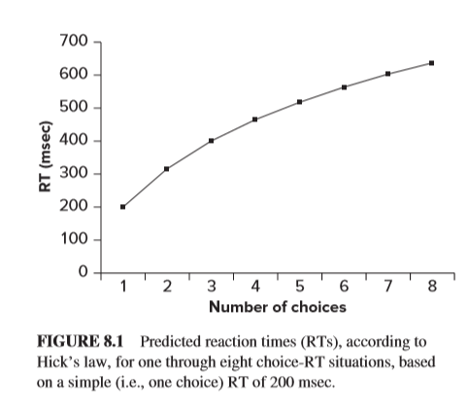
P176 图 8.1
横：选择数量
纵：反应时／RT（毫秒／ms）
FIGURE 8.1 Predicted reaction times (RTs), according to Hick’s law, for one through eight choice-RT situations, based on a simple (i.e., one choice) RT of 200 msec.
根据海克定理预测的反应时（RTs），有8种选择RT的情况，以200m s的简单RT（即一个选择）为选择。

Slide 7
P177 A CLOSER LOOK① Applying Hick’s Law to a Sport Performance Situation
When a soccer player is dribbling the ball down the field and notices that a defender will soon confront him or her, the player has several choices in terms of what to do with the ball. One choice is to continue dribbling; a second is to pass to a teammate; and a third could be, depending on the player’s location on the field, to make a shot at the goal. The player’s decision depends on a variety of factors related to the other players on the field, which include the actions of the individual defender, the locations and actions of the defender’s teammates, as well as the locations and actions of the teammates of the player with the ball. When considered in terms of Hick’s law, all of these players are possible “stimulus” choices. If the player with the ball tried to take into account all of these players’ locations and actions, he or she would need much more time to make a decision about what to do with the ball and prepare the action based on that decision than the situation would allow.
运动表现情况下海克定理的应用 当一个足球运动员带球到操场上而且注意到有一个防守人马上就要拦截他或者她，这个运动员需要在一定的期限之内带着球去做些什么，此时他或她有以下几个选择。第一个选择是去继续运球；第二个选择是传球给队友；第三个可能是根据球员在场上的位置将球射入球门。这个运动员的决定取决于许多的因素，有关于其他在场上的运动员，包括单个防守运动员的动作、该防守运动员的队友的动作以及球的位置。当考虑到依据海克定理，所有这些运动员都可能是“刺激”选择。如果这个带球运动员尝试去考虑到所有运动员的位置和动作，他或者她可能需要更多时间来决定如何处理球，并且在此基础上准备动作，而这不是实际会允许的情况。

Slide 8
P177 A CLOSER LOOK② How does the player reduce the stimulus choices in order to reduce the decision and action preparation time? One way is for the player with the ball to look for the minimum number of specific charac-teristics related to the defenders and his or her own teammates that will provide the information needed to make a decision. As Hick’s law indicates, the fewer characteristics the player needs to observe, the shorter the amount of time he or she needs to decide what to do with the ball and prepare the appropriate action.
运动员如何通过减少刺激选择来减少决定和动作准备的时间？持球运动员的一个方法就是关注更少数量关于防守运动员和防守队员的具体特征，这些特征可以提供需要的信息来做决定。正如海克定理所显示的，运动员需要观察的特征越少，他或者她所需用来做决定如何处理球和准备合适动作的时间就越短。

Slide 9
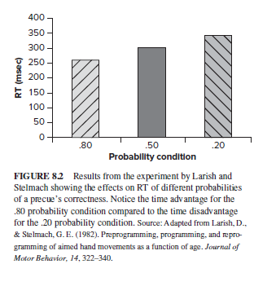
P178 图 8.2 横：先知信息的正确率 纵：反应时RT（毫秒／ms）
FIGURE 8.2 Results from the experiment by Larish and Stelmach showing the effects on RT of different probabilities of a precue’s correctness. Notice the time advantage for the .80 probability condition compared to the time disadvantage for the .20 probability condition. Source: Adapted from Larish, D., & Stelmach, G. E. (1982). Preprogramming, programming, and repro-gramming of aimed hand movements as a function of age. Journal of Motor Behavior, 14, 322-340.
拉力什和斯特马赫的实验结果表明，有预知的情况下预知信息正确性的不同概率对RT的影响。 请注意.80正确率的时间优势与.20正确率的时间劣势相比。 资料来源：改编自Larish，D.和Stelmach，G. E.（1982）。 根据年龄对目标手部动作进行预实验，实验和重新实验。 运动行为杂志，14，322-340。

Slide 10
P179 A CLOSER LOOK① A Stimulus-Response Compatibility Example in the Kitchen with Potential Serious Consequences 一个具有潜在严重后果的厨房中的刺激响应兼容案例
The article by Proctor, Vu, and Pick (2005) described the following example of how S-R compatibility is an important concern for the design of a kitchen appliance. The typical stovetop has four burners, usually arranged in a 2 × 2 layout of two in the front and two in the rear. However, the controls for these burners are organized in ways that vary in the degree of compatibility with the layout of the burners. The following examples illustrate two of these situations:
Proctor，Vu和Pick（2005）的文章描述了以下示例，说明刺激-反应相容性成为厨房电器设计中的一个重要的问题。 典型的炉灶有四个燃烧器，通常以2×2的布局排列，前两个，后两个。 但是这些燃烧器的控件的组织方式与燃烧器的布局的兼容性程度不同。 以下示例说明了其中两种情况：

Slide 11
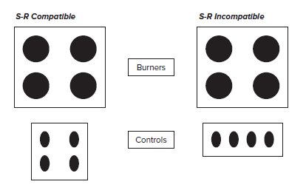
P179 A CLOSER LOOK②
刺激-反应相容
刺激-反应不相容
燃烧器
控件

Slide 12
P179 A CLOSER LOOK③
The selection of the correct controls is easy and fast for the high-S-R-compatible arrangement, but more difficult and slower for the S-R-incompatible arrangement. The potential for making a control selection error, with pos- sible serious consequences, is much higher for the incompatible arrangement, especially in an emergency situation when a fast and accurate response is required.
对于高刺激-反应相容的装置，正确控件的选择是容易和快速的，而对于刺激-反应不相容的装置，选择困难且较慢。 对于不兼容的设备，可能会产生控制选择错误，并可能导致严重的后果，特别是在紧急情况下，需要快速而准确的响应时。

Slide 13
P181 A CLOSER LOOK① The Classic Experiment of Henry and Rogers (1960)
亨利和罗杰斯的经典实验
Henry and Rogers (1960) hypothesized that if people prepare movements in advance, a complex movement should take longer to prepare than a simple one. In addition, the increased preparation time should be reflected in changes in reaction time (RT). To test this hypothesis, they compared three different rapid-movement situations that varied in the complexity of the movement. The least complex movement required participants to release a telegraph key as quickly as possible after a gong (movement A). The movement at the next level of complexity (movement B) required participants to release the key at the gong and move the arm forward 30 cm as rapidly as possible to grasp a tennis ball hanging from a string. The most complex movement (movement C) required participants to release the key at the gong, reach forward and strike the hanging tennis ball with the back of the hand, reverse direction and push a button, and then finally reverse direction again and grasp another tennis ball. Participants were to perform all of these movements as quickly as possible.
亨利和罗杰斯(1960)假设认为，如果人们的提前准备动作，那么复杂运动与简单运动相比需要使用更长的时间用来准备。此外，这个增加的准备时间会反映在反应时(RT)的改变上。为了验证这个假设，他们对比了三种不同的快速运动情况，并且它们的复杂程度各不相同。复杂度最低的运动要求受试者在响铃之后尽可能快速地放开电报按键（运动A）。复杂度第二个级别的运动（运动B）要求受试在铃响时放开按键并且移动上肢去30cm处尽可能快速地抓住一个吊在线上的网球。复杂度最高的运动则是（运动C）要求受试者在铃响时放开按键，向前使用手背击中悬挂的网球，并且向反方向按一个按钮，最终再次反向抓住另一个网球。受试者需要在完成所有动作时都需要尽可能快速。

Slide 14
P181 A CLOSER LOOK②
The results supported the hypothesis. The average RT for movement A was 165 msec; for movement B the average RT was 199 msec; and for movement C the average RT was 212 msec.
The researchers held that the cause of the increase in RT was the increase in the amount of movement- related information that had to be prepared. They pro-posed that the mechanism involved in this movement preparation was a motor program, similar to a com-puter program, that would control the details of the sequence of events required to perform the movement.
这个结果支持假设。运动A的平均RT为165毫秒；运动B的平均RT为199毫秒；运动C的平均RT为212毫秒。
研究者认为RT增加的原因是需要进行准备的运动相关信息数量的增多。他们指出在这个运动准备涉及的机制是一种运动程序，类似于计算机程序，这个程序将控制执行运动所需的事件顺序的详细信息。

Slide 15
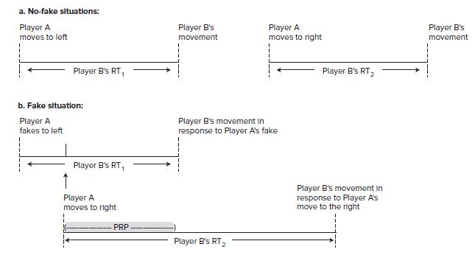
P182 FIGURE 8.3 图8.3
a.无假动作的情况
运动员A向左运动
运动员A向右运动
运动员B的运动
运动员B的运动
运动员B的反应时1
运动员B的反应时2
b.假动作的情况
运动员A假装向左运动
运动员B对运动员A假装向左运动的反应
运动员B的反应时1
运动员A向右运动
运动员B对运动员A向右运动的反应
运动员B的反应时2

Slide 16
P182 FIGURE 8.3 图8.3
The psychological refractory period (PRP) illustrated in terms of the time advantage gained by an athlete for moving to the right when it follows a fake for moving to the left. (a) Player B’s RT when Player A moves to the left (RT1) or the right (RT2), when neither is preceded by a fake in the opposite direction. (b) Player B’s RT when Player A first fakes moving to the left but then moves to the right. In this situation, Player A gains extra time to carry out the move to the right because of the increased RT2 for Player B, which results from the delay caused by the PRP.
心理延迟期(PRP)以运动员进行一个向左的假动作后再移动到右边所获得的时间优势来说明。(a) 运动员A运动到左边（RT1）或右边（RT2）且两者都没有运动之前向反方向的假动作时，运动员B的反应时RT。(b) 运动员A先假动作运动到左边然后运动到右边时，运动员B的反应时RT。在这种情况下，运动员A获得了额外的时间移动到右边因为这样导致了PRP的延迟从而增加了运动员B的RT2。

Slide 17
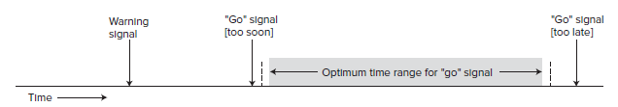
P184 FIGURE 8.4 图8.4
“开始”信号
（太快）
“开始”信号
（太慢）
警告信号
“开始”信号的最佳时间范围
时间
An illustration of the warning signal to “go” signal time relationship necessary to ensure optimal readiness to respond in a reaction time situation. The actual amounts of time for these events depend on the task and situation in which they are performed.
警告信号“开始”信号时间关系的图示，该关系对于确保在反应时间情况下最佳准备做出响应是必要的。 这些事件的实际时间长短取决于执行它们的任务和情况。

Slide 18
P185 A CLOSER LOOK① Vigilance Problems Resulting from Closed-Head Injury
闭合性头部损伤引起的警戒问题
Closed-head injury involves brain damage and often results from an auto accident or a fall. Numerous cognitive and motor problems can accompany this type of injury, depending on the area of the brain that is damaged. Included in the problems associated with closed-head injury is difficulty sustaining attention over a period of time in vigilance situations.
Loken et al. (1995) provided evidence for this difficulty by comparing patients with severe closed-head injuries to non-brain-injured people. All participants observed on a computer screen sets of two, four, or eight small blue circles (1.5 mm diameter). On some trials, one of the circles was solid blue (this occurred on only 60 percent of the 200 trials). When par-ticipants detected the solid blue circle, they were to hit a specified keyboard key. The set of trials lasted 20 min, with only 2 to 5 sec between trials.
闭合性头部损伤涉及了脑部损伤而且通常由交通意外或者坠落引起。神经性认知和运动问题可能会伴随这种损伤发生，这取决于脑部损伤的位置。与闭合头部损伤相关的问题包括在警戒情况下难以持续一段时间的注意力。
洛肯等人（(Loken et al ，1995)通过对比患有严重闭合性脑损伤的患者与无脑损伤人群为这个难题提供了证据。所有的受试者观察到一个分为2、4、8块蓝色小圆圈（直径1.5毫米）的电脑屏幕。在一些试验中，一些圆圈是蓝色实心的（出现次数只占200次试验的60%）。当受试者检测到蓝色实心圆圈时，他们会去敲击一个指定的按键，这个系列的试验持续20分钟，其间只有2-5秒的间隔。

Slide 19
P185 A CLOSER LOOK② Vigilance Problems Resulting from Closed-Head Injury
闭合性头部损伤引起的警戒问题
The authors pointed out that the following results were most noteworthy because they added to previous knowledge of vigilance problems related to closed-head injury. In contrast to the non-brain-injured participants, the patients showed that their:
1. overall vigilance performance was differentially affected by the complexity of the stimulus array on the computer screen (i.e., detection performance decreased as the set size of circles increased)
2. detection time latency (RT) increased as a func-tion of the length of time engaged in performing the task (i.e., the amount of time taken to detect a solid blue circle increased linearly across the 200 trials)
作者指出，以下结果是最有意义的，因为它们增加了与闭合性颅脑损伤有关的警戒问题的先验知识。 与无损伤的受试者相反，这些患者表明：
1.整体警戒情况受到计算机屏幕上不同复杂性刺激的影响（即随着设置的圆圈大小的增加，检测性能会下降）
2.检测时间潜伏期（RT）随着执行任务所需时间的增加而增加（即检测到一个完整的蓝色圆圈所花费的时间在200个试验中呈线性增加）

Slide 20
P186 A CLOSER LOOK① A Summary of Task and Performer Characteristics that Influence the Amount of Time Required to Prepare an Action
影响动作准备所需时间的任务环境和操作者特征的总结
Characteristics that Increase Action Preparation Time 增加动作准备时间的特征
An increase in the number of movement alternatives
An increase in the unpredictability of the correct movement response alternative
Following an expectation bias toward performing one of several movement alternatives, the required movement is not the one expected
An increase in the degree of spatial incompatibility between environmental context features and their associated movements
An increase in the irregularity of foreperiod lengths in an RT situation
No previous experience (i.e., practice) performing the task in the required situation
A decrease in performer alertness
An attention focus on the movement rather than the “go”signal
运动（反应）选择的数量增加/反应选择的数量
正确运动反应选择的不可预测性增加/正确反应的可预测性
在期望（预期）倾向于从几种运动选择中选取一种，而所需的运动不是所期望（预期）的运动/先验信息的正确率
环境特征及其相关运动之间的空间不相容程度增加/刺激-反应相容性
RT情况下前中期长度的不规则性增加/信号前期的常规性
在所需情况下执行任务没有以前的经验（即练习）
操作者警觉性下降
注意力集中在运动而不是“开始”信号上

Slide 21
P186 A CLOSER LOOK② A Summary of Task and Performer Characteristics that Influence the Amount of Time Required to Prepare an Action
Characteristics that Decrease Action Preparation Time 减少动作准备时间的特征
A decrease in the number of movement alternatives
An increase in the predictability of the correct movement response alternative
Following an expectation bias toward performing one of several movement alternatives, the required movement is the one expected
An increase in the degree of spatial compatibility between environmental context features and their associated movements
An increase in the regularity of foreperiod lengths in an RT situation
An increase in the amount of experience (i.e., prac-tice) performing the task in the required situation
An appropriate level of performer alertness
An attention focus on the “go” signal rather than the movement
运动（反应）选择的数量减少/反应选择的数量
正确运动反应选择的可预测性增加/正确反应的可预测性
在期望倾向于从几种运动选择中选取一种，而所需的运动正是所期望的运动/先验信息的正确率
环境特征及其相关运动之间的空间相容程度增加/刺激-反应相容性
RT情况下前中期长度的有规律的增加/信号前期的常规性
在所需情况下执行任务有经验量的增加（即练习）
操作者警觉性提高
注意力集中在“开始”信号而不是运动上

Slide 22
P188 A CLOSER LOOK① Anticipatory Postural Adjustments in Hemiparetic Stroke Patients Compared to Healthy Adults 与健康成年人相比，偏瘫性卒中患者的预期姿势调整
Following a stroke, people commonly experience paralysis on one side of the body (i.e., hemiparesis). One of the motor control characteristics influenced by hemiparesis is the impairment of the anticipatory postural adjustments of the trunk and limbs prior to an intended movement of either a paretic (i.e., para-lyzed) or nonparetic limb. A study by Dickstein, Shefi, Marcovitz, and Villa (2004) provided some insight into this problem by investigating the antici-patory postural adjustment characteristics of specific trunk muscles for arm and hip flexion movements.
Participants: 50 hemiparetic men and women (mean age = 72 yrs) who had experienced a stroke approxi-mately one month prior to the study. The stroke in all patients involved the middle cerebral artery. Some had left hemiparesis and some had right hemiparesis.
人们在中风后通常会在身体的一侧出现麻痹（即偏瘫）。在进行肢体瘫痪（即瘫痪）或非肢体瘫痪的预期运动之前，受偏瘫影响的运动控制特征之一是躯干和四肢预期姿势调整的损伤。Dickstein，Shefi，Markovitz和Villa（2004）进行的一项研究通过调查特定躯干肌肉的预期姿势调整特性（针对手臂和髋部屈曲运动）提供了对该问题的一些见解。
受试者：研究前一个月左右中风的50名偏瘫男女（平均年龄= 72岁）。 所有患者的中风均累及大脑中动脉。 一些患有左偏瘫，一些患有右偏瘫。

Slide 23
P185 A CLOSER LOOK② Anticipatory Postural Adjustments in Hemiparetic Stroke Patients Compared to Healthy Adults 与健康成年人相比，偏瘫性卒中患者的预期姿势调整
In addition, 30 healthy men and women (mean age = 71 yrs) were involved as a healthy control group.
Tasks: Flexion (as fast as possible) of (1) paretic arm of the patients and left arm of the controls; (2) nonparetic arm of the patients and right arm of the controls; (3) paretic hip of the patients and left hip of the controls; (4) nonparetic hip of the patients and right hip of the controls
EMG recording: Posterior trunk (back muscles):
bilateral lumbar erector spinae and latissimus dorsi muscles; anterior trunk (abdominal muscles): bilat-eral rectus abdominis and external oblique muscles; arm flexors: anterior deltoid and biceps brachii mus-cles; hip flexors: rectus femoris muscles
此外，还有30名健康的男性和女性（平均年龄= 71岁）作为健康对照组。
任务：（1）患者的患侧（偏瘫侧）和对照组的左臂（尽可能快地屈曲）； （2）患者的健侧（非偏袒侧）和对照组的右臂； （3）患者的患侧髋骨和对照组的左髋； （4）患者的健侧和对照组的右髋
EMG记录：后躯干（背部肌肉）：双侧腰直肌脊柱和背阔肌; 前躯干（腹肌）：双侧腹直肌和外斜肌； 臂屈肌：前三角肌和肱二头肌臂肌； 髋屈肌：股直肌

Slide 24
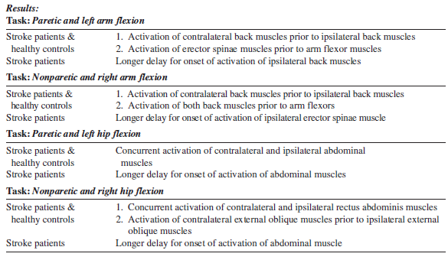
P185 A CLOSER LOOK③
结果： 任务：患侧和左臂屈曲
脑卒中患者&健康控制 | 1.在对侧背部肌肉之前激活对侧背部肌肉 2.在臂屈肌之前激活竖脊肌
脑卒中患者 | 延迟激活同侧背部肌肉
任务：健侧和右臂屈曲
脑卒中患者&健康控制 | 1.在对侧背部肌肉之前激活对侧背部肌肉 2.在屈肌之前激活两个背部肌肉
脑卒中患者 | 较长时间延迟开始激活同侧竖脊肌
任务：患侧和左髋屈曲
脑卒中患者&健康控制 | 同时激活对侧和同侧腹肌
脑卒中患者 | 腹肌激活开始的延迟时间更长
任务：健侧和右髋屈曲
脑卒中患者&健康控制 | 1.同时激活对侧和同侧腹直肌 2.在对侧外斜肌之前激活对侧外斜肌
脑卒中患者 | 腹肌激活延迟时间更长

Slide 25
P185 A CLOSER LOOK④ Anticipatory Postural Adjustments in Hemiparetic Stroke Patients Compared to Healthy Adults
Conclusions: The longer delay for the onset of back and abdominal muscles indicates that the anticipa-tory postural adjustment activity of these muscles is impaired in hemiparetic poststroke patients. The implication of these results for physical rehabilitation is that treatments should include the enhancement of activation levels of these trunk muscles on the paretic side of the body, with special consideration given to the latissimus dorsi, external oblique, and rectus abdominis muscles.
结论：背部和腹部肌肉发作的延迟时间更长，表明这些偏瘫患者的预期肌肉姿势调节活动受到损害。这些结果对身体康复的影响是治疗应包括增强这些身体躯干侧躯干肌的激活水平，并特别考虑背阔肌，外斜肌和腹直肌。

Slide 26
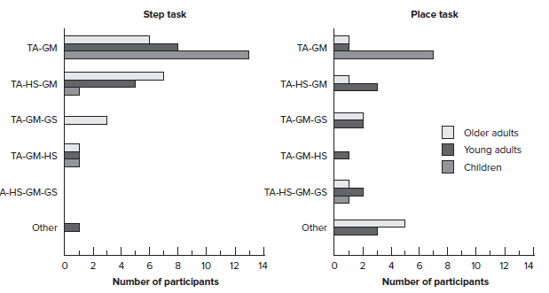
P189 FIGURE8.5①
踏上任务
放置任务
老年组
青年组
儿童组
其他
其他
受试者的数量
受试者的数量

Slide 27
P189 FIGURE8.5②
Results of the experiment by Mercer and Sahrmann (1999) showing the number of children, young adults, and older adults who exhibited specific “preferred” sequences of muscle activation for the stance leg for the place and step tasks. Each sequence indicates the order of activation for the muscles listed (TA = tibialis anterior, GM = gluteus maximus, HS = hamstring, GS = gastrocnemius-soleus). [Figure 4, p. 1149 in Mercer, V. S., & Sahrmann, S. A. (1999). Postural synergies associated with a stepping task. Physical Therapy, 79, 1142–1152.]
Mercer和Sahrmann（1999）的实验结果显示，对于站立和行走任务，站立腿表现出特定的“首选”肌肉激活序列的儿童，青年和老人的数量。 每个序列表示列出的肌肉的激活顺序（TA =胫骨前肌，GM =臀大肌，HS =绳肌，GS =腓肠肌-比目鱼肌）。 ［图4，p. 1149年在Mercer，V. S.和Sahrmann，S. A.（1999）中发表。 与步进任务相关的姿势协同作用。 物理疗法，79，1142–1152。]

Slide 28
P190 A CLOSER LOOK① Achieving a Standing Posture from Various Sitting Postures: An Example of How Functional Demands Affect Action Preparation
从各种坐姿中获取站立姿势：功能需求如何影响动作准备的示例
Changing from a sitting posture to a standing pos-ture (referred to as a sit-to-stand action) is a com-mon everyday activity that provides a good example of how the motor control system adapts to allow the same action to occur from a variety of initial postural positions. Shepherd and Gentile (1994) presented evidence of this adaptability by having healthy adults sit in different postures on a chair (an erect trunk, a fully flexed trunk, and a partially flexed trunk, i.e., flexed between the fully flexed and erect positions), and then stand. Analyses of the various joint move-ments involved in this action showed this:
In the erect and partially flexed sitting postures: The knee began to extend before the hip joint began to extend.
In the fully flexed sitting posture: the hip joint began to extend before the knee began to extend.
从坐姿更改为站立姿势（称为从坐到站的动作）是一项常见的日常活动，它提供了一个很好的示例，说明运动控制系统如何适应去从各种初始姿势位置变为一个相同的动作。 Shepherd and Gentile（1994）通过让健康的成年人以不同的姿势坐在椅子上然后站起来的方式（躯干挺直，躯干完全弯曲以及躯干部分弯曲，即在完全弯曲和挺直之间的程度）展示了这种适应性的证据 。 对参与此运动的各种联合运动的分析表明：
以直立和部分屈曲的坐姿：膝盖的伸展先于髋关节的伸展。
处于完全弯曲的坐姿：髋关节开始伸展先于膝盖开始伸展。

Slide 29
P190 A CLOSER LOOK② Achieving a Standing Posture from Various Sitting Postures: An Example of How Functional Demands Affect Action Preparation
从各种坐姿中获取站立姿势：功能需求如何影响动作准备的示例
These different initiation patterns of joint movements illustrate how functional demands influence the order of muscle activation in preparing an action. Because different sitting postures will require different sup-port, propulsion, and balance characteristics during the sit-to-stand action, the order of the initiation of movement of the knee or hip joints is a critical factor in enabling a person to carry out the intended action without losing balance.
关节运动的这些不同初始运动方式说明了功能需求如何影响准备动作时肌肉激活的顺序。 由于不同的坐姿将需要不同的支撑，推动和平衡特性，因此，膝关节或髋关节运动开始的顺序是使人能够在不失去平衡的情况下进行预定的动作进行锻炼的关键因素 。

Slide 30
P191 A CLOSER LOOK① Performance Expectations as Part of Action Preparation
动作执行期望作为动作准备的一部分
Often overlooked in the study of motor learning and control is the role of motivation to perform a skill. A motivational variable known as performance expec-tancies, which refers to a performer’s expectations of how he or she will perform a skill, is particularly relevant to the action preparation process. A study by Stoate, Wulf, and Lewthwaite (2012) presents a notable example of the influence of a performer’s expectancies on the person’s quality of performance, with particular emphasis on the efficiency of that performance (with the term efficiency referring to the amount of energy used to perform a skill, i.e., lower energy use indicates higher efficiency). In addition to presenting an experiment designed to test their per-formance expectancy effect hypothesis, the authors also provide an excellent review of research describ-ing the motivational effects of various forms of influencing expectancies for both novice and skilled performers.
在运动学习和控制研究中经常被忽视的是执行一项技能的动机。 动机变量称为动作执行期望，指的是运动员对他或她将如何表现技能的期望，这与动作准备的过程特别相关。 Stoate，Wulf和Lewthwaite（2012）的一项研究提供了一个显着的例子，表明运动员的期望对个人运动表现质量的影响，特别强调表现的效率（效率一词是指用于执行一项技能的能量，即较低的能量使用表示较高的效率）。除了提出旨在测试其预期绩效假设的实验外，作者还提供了出色的研究综述，描述了各种影响期望值的形式对初学者和熟练者动机的影响。

Slide 31
P191 A CLOSER LOOK② Performance Expectations as Part of Action Preparation
动作执行期望作为动作准备的一部分
The “Performance Expectancy Effect” Hypothesis
Because a performer’s expectancies about an upcom-ing performance will influence the outcome of that performance, variables that influence those expectan-cies will affect the quality of the performance, espe-cially in terms of movement efficiency.
The Experiment
Participants: Male and female members of a running club (average age of 26 years), who had been run-ning close to 50 km per week for an average of eight years.
“动作执行预期效应”假说
因为运动员对即将来临的运动的期望会影响动作的结果，所以影响那些期望的变量会影响动作的质量，尤其是在运动效率方面。
实验
受试者：跑步俱乐部的男女成员（平均年龄26岁），他们每周跑步近50公里，平均运动年限八年。

Slide 32
P191 A CLOSER LOOK③ Performance Expectations as Part of Action Preparation
动作执行期望作为动作准备的一部分
Task and Procedures: Participants ran on a treadmill on two days. The first day involved establishing their baseline performance characteristics engaging them in a standard graded exercise test for a maximum of 20 minutes. On the second day participants ran for 20 minutes on the treadmill at a speed equivalent to 75 percent of their maximum oxygen consumption, which had been determined on day 1. Prior to and after the day 2 running session, participants were given questionnaires asking them to rate the ease of their running.
Two groups were formed on day 2. After run-ning for 10 minutes, the Enhanced Expectancy group received feedback about their oxygen consumption every 2 minutes for the duration of their run. They were told that their oxygen consumption was in the top 10 percentile for their age and gender. The Control group was not given any feedback about their oxygen consumption while they ran.
任务和程序：受试者在跑步机上跑步两天。 第一天涉及建立他们的基线表现特征，使他们参加标准的分级运动测试，最长不超过20分钟。 第二天，受试者在跑步机上跑步20分钟，其速度相当于他们在第1天确定的最大耗氧量的75％。在第2天跑步之前和之后，向受试者提供问卷调查表，要求他们评价他们自己的跑步难易程度。
在第2天形成两组。跑步10分钟后，增强期望组在跑步过程中每2分钟收到有关其氧气消耗的反馈。 他们被告知他们的氧气消耗量在其年龄和性别中位居前十位。 对照组在奔跑时没有得到关于其氧气消耗的任何反馈。

Slide 33
P191 A CLOSER LOOK④ Performance Expectations as Part of Action Preparation
动作执行期望作为动作准备的一部分
Performance Evaluation: Oxygen consumption, heart rate, and perceived exertion were measured for all participants.
Results: The primary result was that oxygen con-sumption rates were comparable between the two groups for the first 10 minutes but then systematically decreased for the Enhanced Expectancy group for the remainder of the 20-minute running session. No change in oxygen consumption rate occurred for the Control group.
Conclusion： Movement efficiency can be influenced by perfor-mance expectancies that are associated with informa-tion that persuades the performer that he or she has an efficient technique. As a result, these expectancies become part of the action preparation process.
绩效评估：测量所有参与者的耗氧量，心率和感知疲劳。
结果：主要结果是，在最初的10分钟内，两组的氧气消耗率相当，但在接下来的20分钟的跑步过程中，增强期望组的氧气消耗率有系统地降低。 对照组的耗氧率没有变化。
结论：运动效率会受到绩效预期的影响，而绩效预期与说服运动员具有有效技术的信息有关。 结果，这些期望成为行动准备过程的一部分。

Slide 34
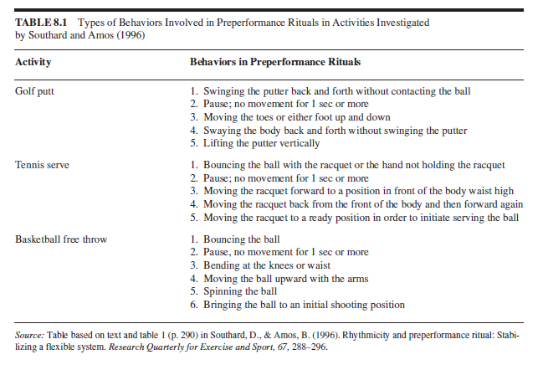
P194 TABLE 8.1
表8.1 绍萨德和阿莫斯（1996）调查的活动中涉及表现前仪式的行为类型
活动 | 表现前仪式的行为类型
高尔夫推杆 | 1.在不接触球的情况下来回摆动推杆 2.暂停;1秒或更长时间不移动 3.移动脚趾或上下移动脚 4.来回摆动身体而不会挥动推杆 5.垂直提起推杆
网球发球 | 1.用球拍或不握球拍的手弹跳球 2.暂停;1秒或更长时间不移动 3.将球拍向前移动到身体腰部前方的位置 4.将球拍从身体的前面移回，然后再次向前移动 5.将球拍移至准备位置以开始发球
篮球罚球 | 1.拍起球 2.暂停,持续1秒钟或更长时间不动 3.弯曲膝盖或腰部 4.用手臂向上移动球 5.旋转球 6.将球带到投射的初始位置
资料来源：索瑟德·D·阿莫斯·B（1996）中基于文字的表格和表格1（第290页）。 节律和表现前仪式：使一个灵活的系统变稳定。 运动与运动研究季刊，67，288-96。

Slide 35
CHAPTER 8 ACTION PREPARATION
END

Slide 36
Participants：受试者
Action prepration ：动作准备
Performance ：表现、执行-操作、绩效（工科）
Trial：试验，尝试

